Slide 1
Inclusion Group
Hannah Curtis
Nick Geering
Andy Taylor-Doyle
Liz Francis

Slide 2
https://www.youtube.com/shorts/Akt22gVjf-s

Slide 3
Why is ADHD called ADHD?
AD for me
Diagnosis and what to expect
HD for me

Slide 4
How can church help? “How can I help you help yourself?”

Slide 5
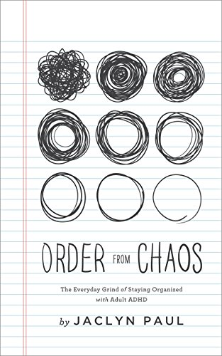
Facebook group communities
Some useful resources and books

